Slide 1
Leeds Neighbourhood Networks report
Centre for Ageing Better
March 2022

Slide 2
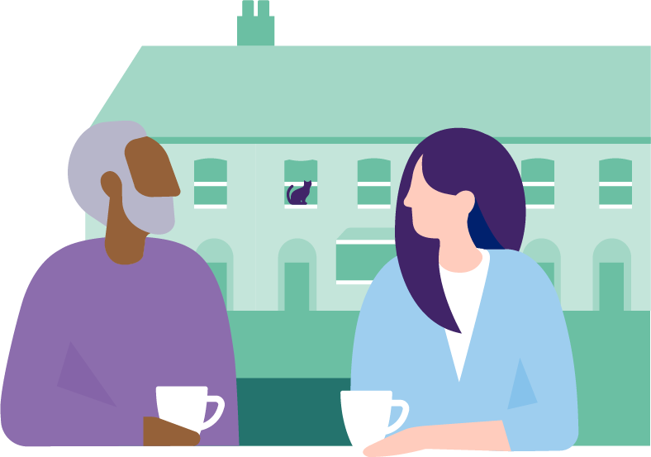
How do community organisations contribute to healthy ageing?

Slide 4
What are the Leeds Neighbourhood Networks?
They are local schemes that aim to support older people to remain living independently and to participate in their communities through a range of neighbourhood-based activities and services.
Currently, there are 37 Neighbourhood Networks provided by 32 different organisations across the city of Leeds.
Activities/services include:
Opportunities for social connection and interaction
Support to engage in physical activity or exercise
Learning and development opportunities
Befriending schemes
Food-and-nutrition support
Transport
Frailty and long-term-conditions clinics
Volunteering opportunities
General information, advice and guidance

Slide 5
What is Healthy Ageing?
The World Health Organisation defines healthy ageing as:
“The process of developing and maintaining the functional ability that enables wellbeing in older age”
This ability allows people to:
Meet their basic needs
Learn, grow and make decisions
Be mobile
Build and maintain relationships
Contribute to society

Slide 6
Evaluating the contribution of the Leeds Neighbourhood Networks
Drawing on the experience of volunteers, staff and members, the evaluation examined the contribution of the Leeds Neighbourhood Networks to three stages of ‘healthy ageing’:
Prevent: prevention of ill health through community-based activities and support
Delay: helping people to manage long-term conditions in order to delay illness severity and maintain a good quality of life, as well as ease the demand on health and social care services
Reduce: assisting individuals with significant support needs, including frail older people and/or those with chronic or multiple conditions such as dementia or cancer, in order to reduce pressure on healthcare providers

Slide 7
What is Healthy Ageing?
Methodology
Qualitative, evidence-based evaluation
Building on phase 1 of the COVID-19 Real-Time Evaluation
Six in-depth case studies of Leeds Neighbourhood Networks:
Review of existing data and evidence
8-12 interviews per case study (staff, members, volunteers, stakeholders) – 58 in total
Result
A large, rich qualitative dataset enabling understanding of how the Leeds Neighbourhood Networks contribute to healthy ageing (and beyond)

Slide 8
How do the Leeds Neighbourhood Networks contribute to the three stages of healthy ageing?

Slide 9
Prevent
Prevention of ill health through community-based activities and support
Increase in social contact, reducing isolation and loneliness
By giving older people the opportunity to participate in social activities, the Leeds Neighbourhood Networks enable them to build and maintain relationships with their peers and other community members.
“I think the biggest benefit is social interaction” Member
“I do get lonely sometimes, but my daughter thought it would be a good idea [to join a Network]… it’s an absolute godsend” Member

Slide 10
Prevent
Improvement in mental health and wellbeing
As well as providing structure and a sense of purpose to members’ lives, the Leeds Neighbourhood Networks boost older people’s confidence and self-esteem.
“I was going through a bad depression and I couldn’t get into doing anything… they helped me get back into activities, so it’s made me feel a lot better about myself” Member

Slide 11
Prevent
3. Promoting and increasing independence
By offering a range of activities, particularly those which encourage mobility, the Leeds Neighbourhood Networks help its members maintain and improve their independence, which in turn helps to prevent illness.
“We promote independence, and we promote keeping active and healthy, and we do that very well” Staff

Slide 12
Delay
Helping people to manage long-term conditions in order to delay illness severity and maintain a good quality of life
Identifying when health declines and putting the right support in place
Thanks to the relationships the Leeds Neighbourhood Networks develop with their members they are in a unique position to spot declines in health and intervene appropriately.
“When you befriend members face to face you can actually keep an eye on what they are looking like. If they begin to look unwell, you can contact someone to voice your concerns” Volunteer

Slide 13
Delay
Supporting members to deal with and manage long-term health conditions
The Leeds Neighbourhood Networks help delay deterioration in frailty and age-related illnesses such as dementia and cancer. They often work with other health services to support and educate members about health conditions and their management.
“We are able to educate people and help them to understand what they should be doing… it delays the impact on the National Health Service” Volunteer
For example, one neighbourhood network was working with local health services to deliver a course to support people who were frail, suffering from memory issues or needing help with general wellbeing. This covered subjects such as healthy eating, mobility, relaxation and mindfulness.

Slide 14
Reduce
Assisting people with significant support needs to reduce pressure on healthcare providers
Relieving pressure on the health and care system
As well as helping to maintain members’ health and independence, the Leeds Neighbourhood Networks ease the burden on health services by providing information and advice to reduce the number of unnecessary calls and visits to GPs and hospitals.
“People have become more confident contacting us [about a health issue]. Most of the people I would visit in the early days would ring 999” Volunteer
Members are also helped to navigate the wider health and care system.
“Because of COVID, [we help with] understanding systems and getting tests. We are also making sure people get their jabs” Staff

Slide 15
Reduce
Relieving pressure on carers and families
In addition to lending support to the friends and families of members who need respite care, the Leeds Neighbourhood Networks provide them with a general sense of reassurance that their loved-ones are being looked after when they aren’t around.
“It gives his wife respite as well, because we know that it’s quite challenging when he’s struggling at home. It benefits both of their wellbeing” Staff

Slide 16
Lessons learnt from the Leeds Neighbourhood Networks

Slide 17
Reasons for success
Range: Providing members with a range of bespoke activities and opportunities, which enable holistic and personalised care.
Relationships: Building meaningful, trust-based relationships with and between members and volunteers; and with other community organisations and groups.
Responsiveness: Being responsive and sensitive to members’ needs and changing circumstances. In-depth knowledge of members enables staff and volunteers to respond in highly personalised ways.
Reassurance: Providing members and their families with a sense of reassurance and security that support is there for them whenever needed.
To maximise success, they also need…
Resources: All services and organisations require a combination of different sets of resources: funding, good governance, stable leadership, strong workforce, accessible facilities, good reputation and a supportive policy environment.

Slide 18
Implications for health and social care policy
The evaluation of the Leeds Neighbourhood Networks has emphasised the following:
The importance of prevention: The evaluation highlighted the value of the Networks’ activities in terms of preventing the onset of ill health. It is therefore vital to ensure that community-based organisations are supported to undertake such initiatives, even though demand to assist older people with more intensive health and care needs continues to increase.
The value of long-term investment: Core funding has been vital in enabling the Leeds Neighbourhood Networks to develop and sustain their activities over an extended period and provides a platform for future endeavours. All community-based organisations should be provided with core, flexible funding where possible.
The need to prioritise support for older people at a neighbourhood level: The positioning of the Leeds Neighbourhood Networks within local communities is key to their success. They are able to react to the needs of local people and provide a tailored service, which not only has health benefits for their members but also relieves pressure on other health and social care services in the area.

Slide 19
Further evaluation
The final phase of the evaluation of the Leeds Neighbourhood Networks will examine equity and access in community-based-support for older people.
It will focus on the following themes:
Offer: exploring whether a range of services and activities are available in each area according to the needs of local members
Access: understanding barriers to participation – both on a personal level (why someone doesn’t take up a referral to a Neighbourhood Network) and a system level (why some people are referred and others aren’t)
Resource: looking at how the current funding system can be improved or sustained to ensure the Leeds Neighbourhood Networks receive suitable resourcing – both financially and in terms of staffing, volunteers and facilities
This phase commences in March 2022 and will conclude in August 2022.

Slide 20
Thank you
info@ageing-better.org.uk
@ageing_better

